Slide 1
Effect of COVID-19 Vaccine on Education & Death Rates Case Investigation and Reporting
Business Analytics 1 / Final Project
Presented by “ Samar Moussa – Ruwad Alshaar ”

Slide 2
Contents:
An introduction of the global situation of life before and after covid-19 with vaccination rates.
The new normal life and Covid effect on life.
Case study about the number of closed schools and continuation of education.
Study on death rates among populations compared to the vaccinated people.
Prediction of deaths numbers based on the vaccination rates in each country.
Prediction of education effectiveness after covid-19.

Slide 3

Life Before Covid

Slide 4

Life Before Covid

Slide 5
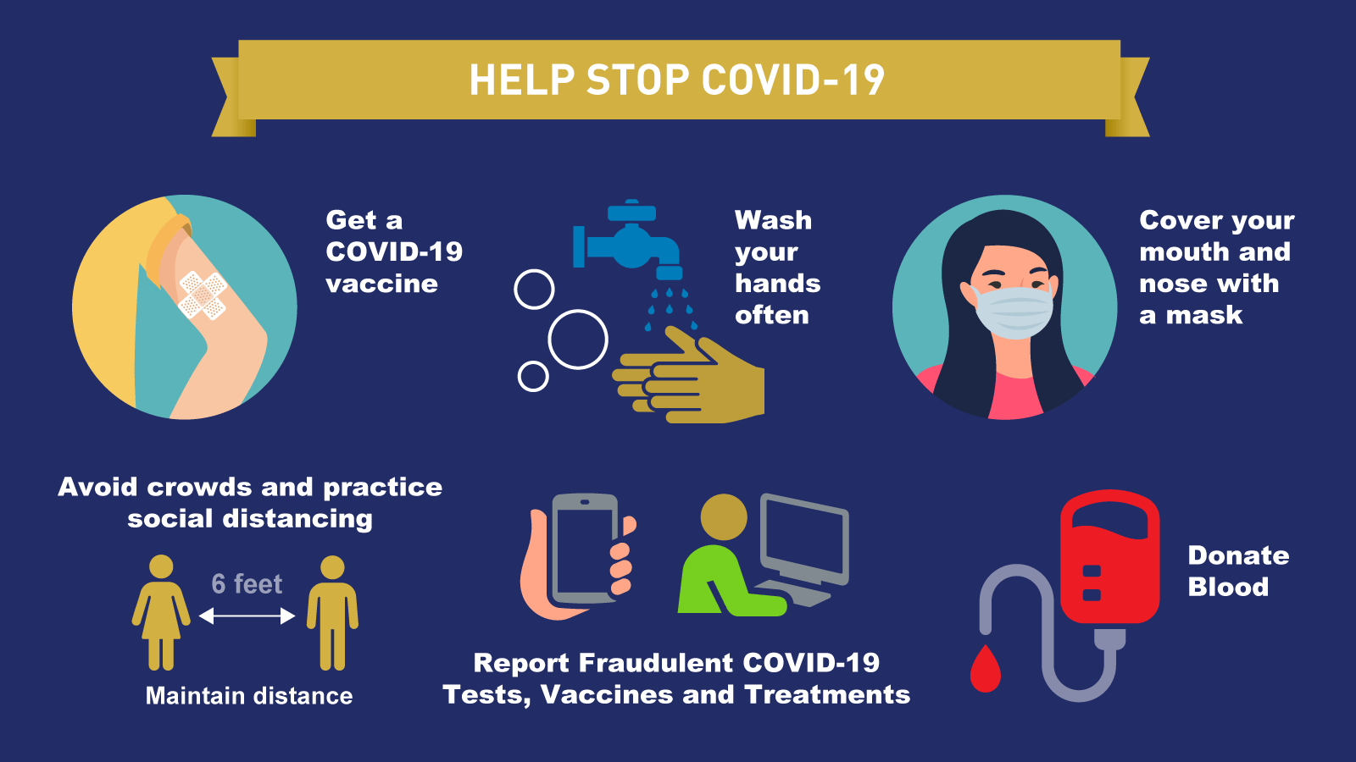
Life after Covid

Slide 6
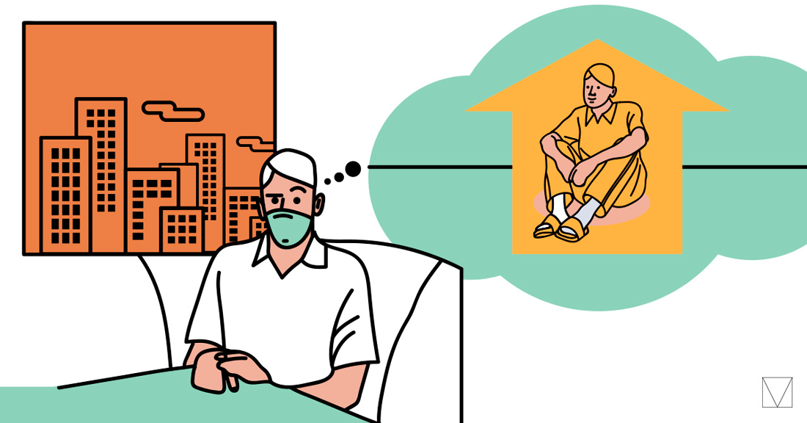
Life after Covid

Slide 7

The New Normal

Slide 8
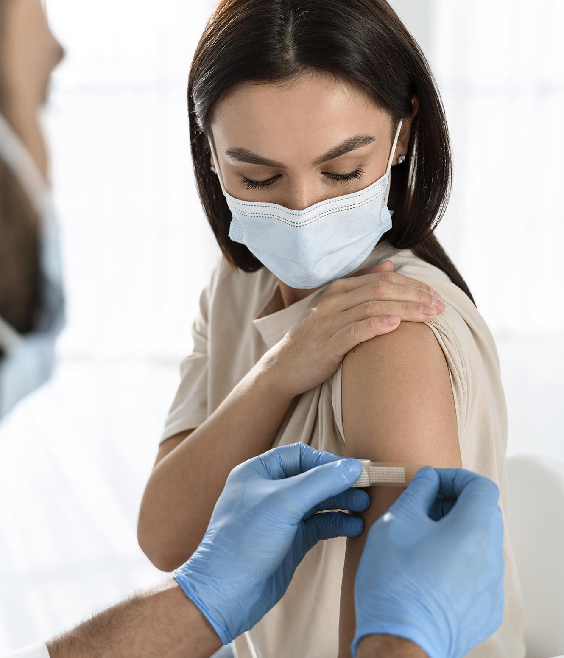
Vaccination & Its Effectivness on Death

Slide 9
What to take into concideration while studying?
Age
Gender
Poverty rate
School closure
Covid-19 cases
Vaccine

Slide 10
Covid and Global Education

Slide 11
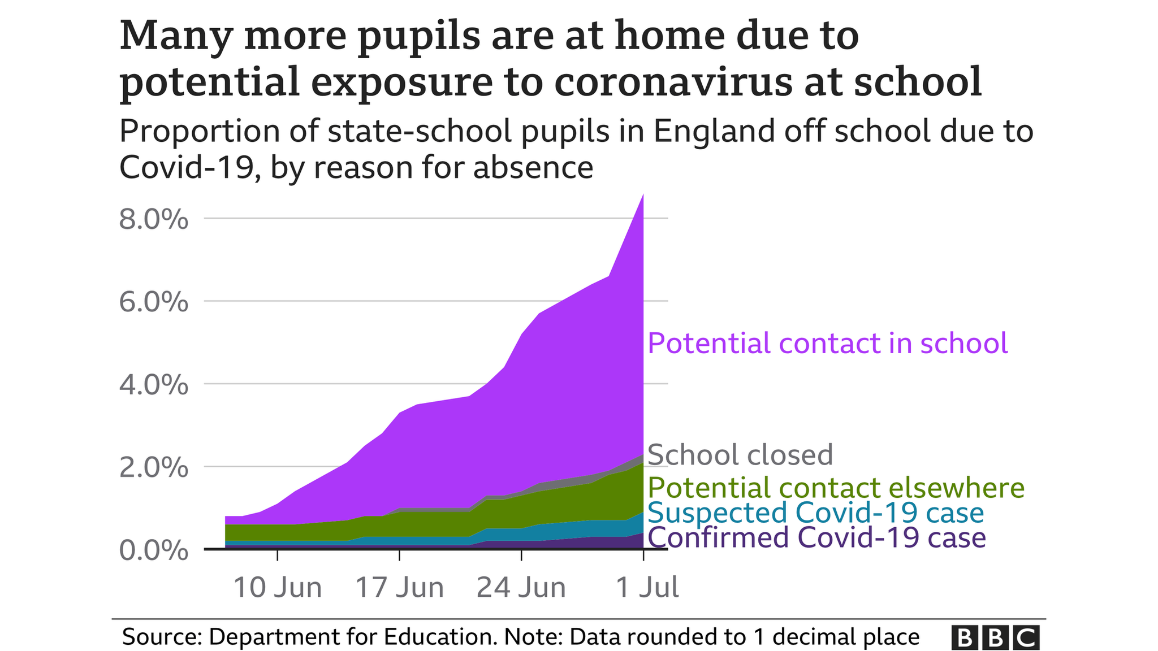

Slide 12
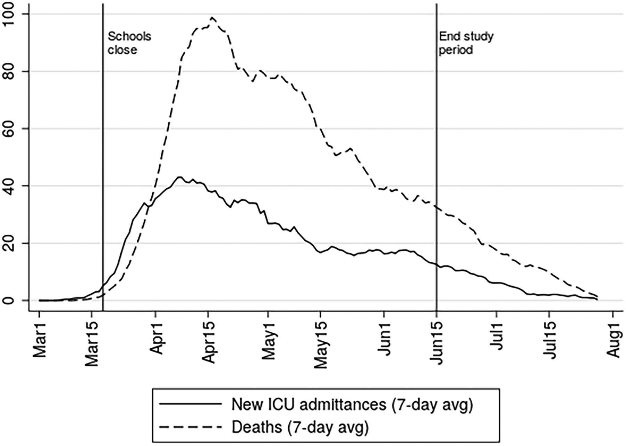
This study shows a relationship between school closure and death rates of covid 19 globally

Slide 13
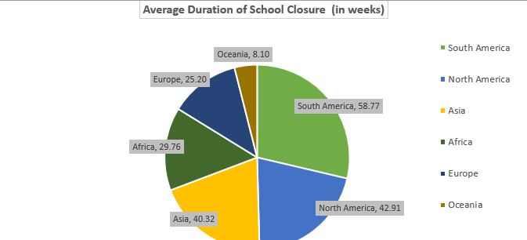
This study shows a relationship between school closure and death rates of covid 19 globally

Slide 14
Predictions and Findings Based on Our Dataset

Slide 15

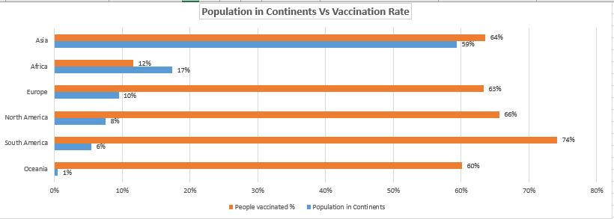

Slide 16
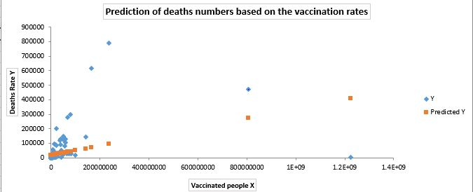

Slide 17
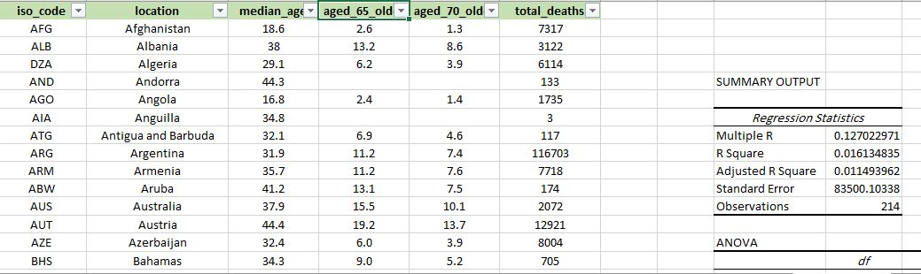

Slide 18
Post-prevention
Social distance
Wear a mask
Daily exercise

Slide 19
Thank You !

